Slide 1
Machine Learning in Predicting Maternal Health Risks: A Comparative Analysis of Some Algorithms
International Conference on Computing and Advances in Information Technology (ICCAIT 2023)
21-23 November 2023, Ahmadu Bello University, Zaria, Nigeria
Presenter: AndrA Umoru
Authors: Andra u., iliyas i. I., Mshelbila m. D., Bwanu p. I.

Slide 2

OUTLINE
Introduction & Background
Methodology & Performance Metrics
Experimental Setup
Conclusion & Future Directions
References
Dataset & Hyperparameter Tuning
Results Comparative Analysis

Slide 3
ABSTRACT
This study aims to evaluate and compare the performance of three (3) supervised machine learning algorithms (Logistic regression, Support Vector Machine, and K-Nearest Neighbour) in predicting maternal health risks.
Key findings: K-NN recorded the highest performance metrics, followed by the SVM, while the Logistic Regression recorded the lowest performance metrics.
This study underscores the potential of Machine Learning in Healthcare delivery, especially within the domain of Maternal health.

Slide 4
INTRODUCTION
ML has found applicability in healthcare in predicting patient outcomes with a significant level of accuracy [1].
ML is increasingly being used in predicting future Maternal Health Risks [2].
We used (3) ML algorithms (LR, SVM, and K-NN) to predict Maternal Health Risks.
The dataset chosen for this work was obtained from the UCI Machine Learning Data repository.
This study aims to harness the potential to identify optimal algorithms for predicting maternal health risks.

Slide 5
BACKGROUND
The rise in the rate of maternal morbidity and mortality has drawn attention to the Public Health space [3].
Within the last decade, the usage of machine learning in the healthcare industry has increased with great success [4].
Many researchers have explored numerous experiments bordering Maternal Health Risks.
Machine Learning Algorithms in focus: LR, SVM, and K-NN.

Slide 6
METHODOLOGY - MODELS
LOGISTIC REGRESSION
➔ Statistical model used for binary classification.
➔ It takes any real-valued number and maps it between 0 and 1.
SVM
➔ A powerful, versatile ML model used for both classification and regression tasks.
➔ It finds the best hyperplane that separates data points of different classes by maximizing the margin between them.
K-NN
➔A simple, non-parametric algorithm used for classification and regression.
➔ It classifies a data point based on how its neighbours are classified, using distance metrics like Euclidean distance.

Slide 7
PERFORMANCE METRICS
➔ Accuracy
➔ Precision
➔ Recall
➔ F1 Score
➔ AUC ROC

Slide 8

DATASETS DESCRIPTION
Obtained from UCI Machine Learning Data repository.
Collected using IoT-based Risk Monitoring System from maternal health care unit in Bangladesh.
Dataset attributes: Age, SystolicBP, DiastolicBP, BS, BodyTemp, HeartRate, and RiskLevel (Label).
RiskLevel: Low Risk, Mid Risk, and High Risk.

Slide 9
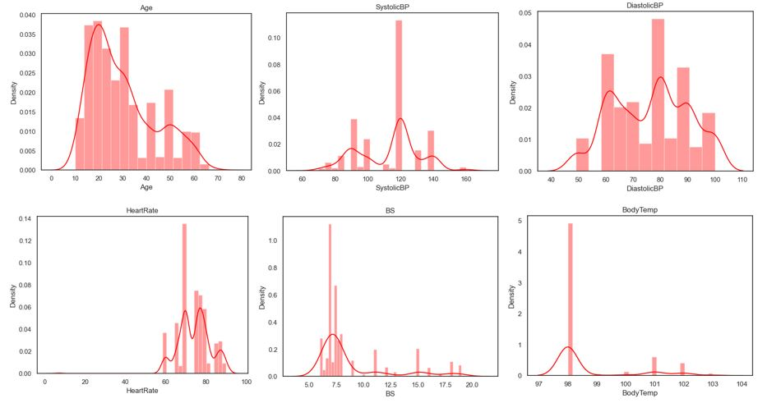
DATASETS DESCRIPTION
➔ The dataset contains 1014 instances.
➔ 70% (709 instances) as the training set.
➔ 30% (305 instances) as the test set.
➔ Changed categorical labels to numeric labels.
➔ Created classification classes by separating features from labels.

Slide 10
HYPERPARAMETER TUNING
1
2
Used GridSearchCV from the Sci-kit learn library.
Parameter Grid was used to define the list of the parameters.

Slide 11
Experimental Setup - Algorithm
Logistic Regression
Regularization ➔ 'C': [0.001, 0.01, 0.1, 1, 10]
Algorithm Optimization ➔ ‘solver’: ['liblinear’]
Multi-Class classification ➔ 'multi_class': ['auto’]
Number of iterations ➔ 'max_iter':[10000]}

Slide 12
Experimental Setup - Algorithm
Support Vector Machine
Regularization ➔ C': [0.1, 1, 10, 100]
Kernel ➔ ['linear’, rbf]
Degree ➔ ‘degree’ [1, 2, 3]
Gamma ➔ ‘gamma’: [‘scale’, ‘auto’]

Slide 13
Experimental Setup - Algorithm
K-Nearest Neighbour
Number of Neighbors ➔ [1,3,5,7,9,11,13,15,17,19]
Weight ➔ ['uniform’, 'distance’]
Metric➔ ['minkowski’, 'euclidean’, 'manhattan']

Slide 14
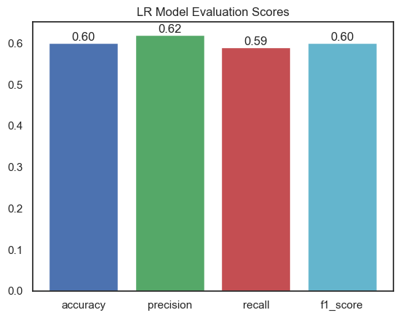
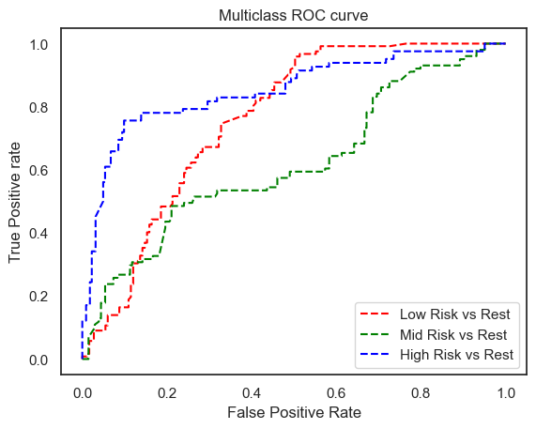
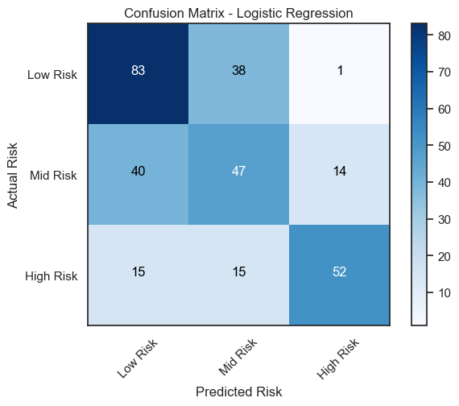
Results – Logistic Regression
Metrics Plot
Multiclass ROC Curve Plot
Confusion Matrix

Slide 15
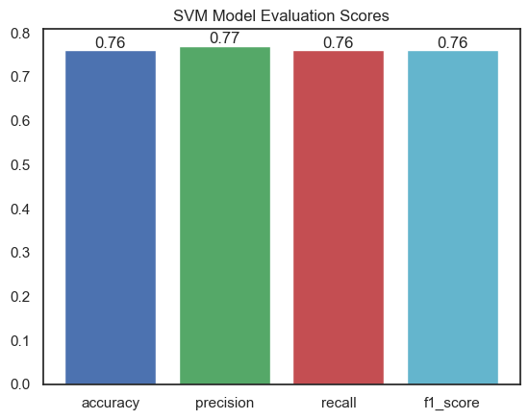
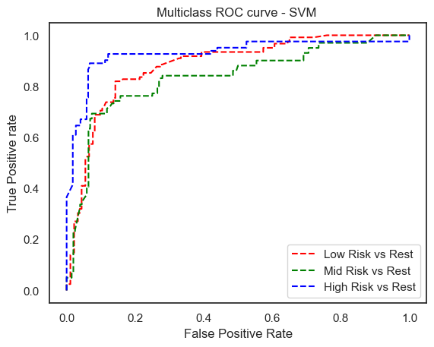
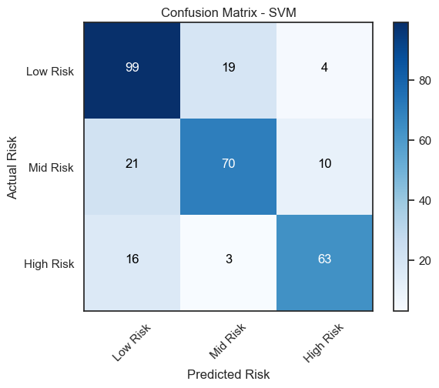
Results – Support Vector Machine
Metrics Plot
Multiclass ROC Curve Plot
Confusion Matrix

Slide 16
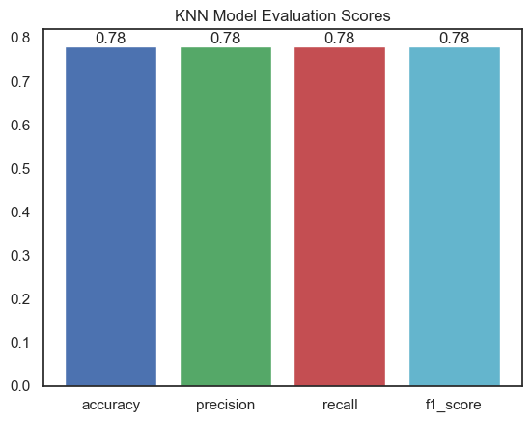
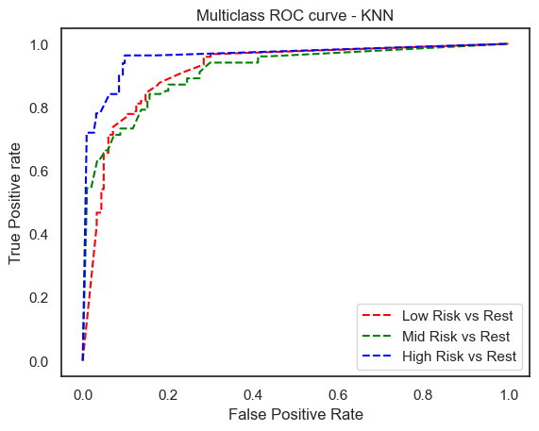
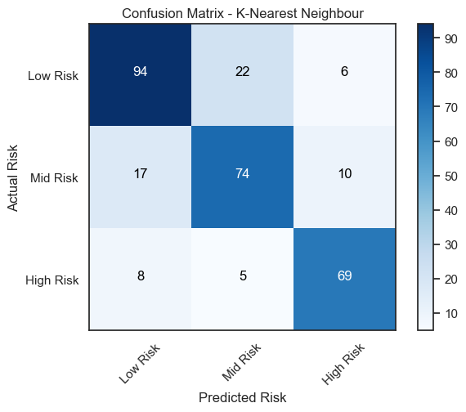
Results: K-Nearest Neighbour
Metrics Plot
Multiclass ROC Curve Plot
Confusion Matrix

Slide 17
Comparative Analysis…
ML MODELS | RISK CLASSES | ACCURACY | PRECISION | RECALL | F1 SCORE | SUPPORT
LOGISTIC REGRESSION | Low Risk – 0 | 0.60 | 0.60 | 0.68 | 0.64 | 122
 | Mid Risk – 1 |  | 0.47 | 0.47 | 0.47 | 101
 | High Risk – 2 |  | 0.78 | 0.63 | 0.70 | 82
SUPPORT VECTOR MACHINE | Low Risk – 0 | 0.76 | 0.73 | 0.81 | 0.77 | 122
 | Mid Risk – 1 |  | 0.76 | 0.61 | 0.73 | 101
 | High Risk – 2 |  | 0.82 | 0.77 | 0.79 | 82
K-NEAREST NEIGHBOUR | Low Risk – 0 | 0.78 | 0.79 | 0.77 | 0.78 | 122
 | Mid Risk – 1 |  | 0.73 | 0.73 | 0.73 | 101
 | High Risk – 2 |  | 0.81 | 0.84 | 0.83 | 82

Slide 18
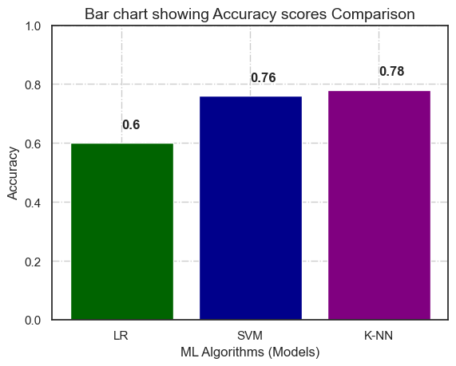
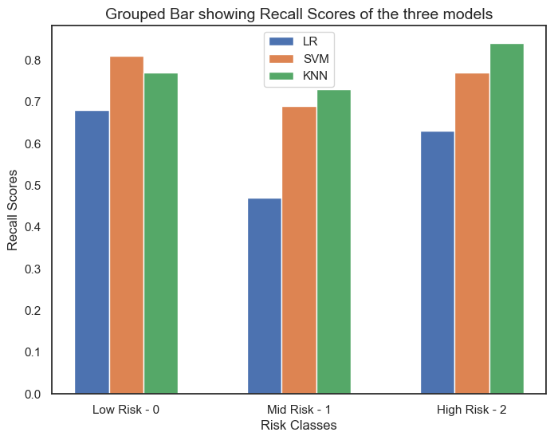
Comparative Analysis Cont’d…
Accuracies Bar Chart Plot
Recall Bar Chart Plot

Slide 19
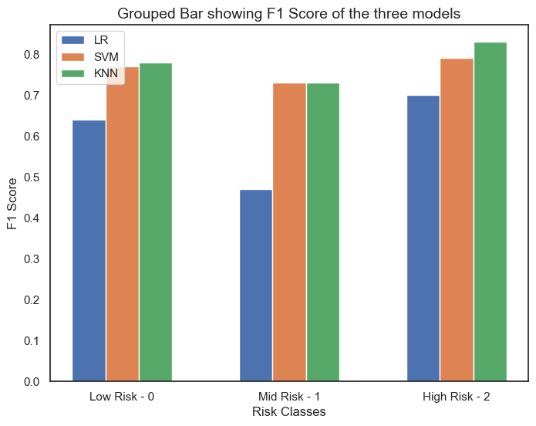
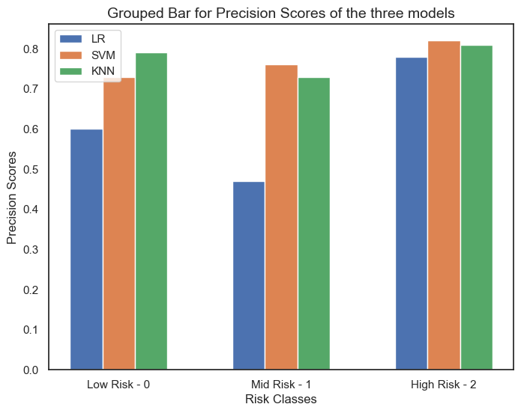
Comparative Analysis Cont’d…
F1 Scores Bar Chart Plot
Precision Score Bar Chart Plot

Slide 20
Discussion – Key findings
Algorithms Performance: The K-NN model demonstrated the highest performance with accuracy, precision, and recall, an F1 score of 78%, and an AUC score of 0.93.
Performance Across Risk Classes: The models did well in predicting the high-risk and low-risk classes while they struggled to classify the mid-risk class, often misclassifying it as either high-risk or low-risk.
Comparative Analysis: The KNN model outperformed the other two in terms of accuracy, recall, and F1 scores, while the SVM stood out for precision.
The logistic regression model recorded the least performance due to the nonlinearity of the relationship between independent and dependent variables.

Slide 21
Conclusion
Although the classification accuracy scores obtained from these models were not above 80%, it can go a long way, providing insights into maternal health risks.
This study will bring about increased efficiency and effectiveness in healthcare delivery.
It can potentially transform maternal healthcare by making it more proactive, personalized, and efficient.
Enhances interdisciplinary collaboration between clinicians, data scientists, and policymakers in improving maternal healthcare.

Slide 22
Future Directions
Preterm Birth Prediction, Postpartum Depression Prediction, and early Prediction of High-Risk Pregnancies should be considered in enhancing maternal health risk prediction.
Some more ML Classification algorithms (Decision Tree, Naïve Bayes, ANN etc.) can be employed to observe their performance in Predicting Maternal Health Risk.
Further hyperparameter tuning with more extended grid parameter values can be employed.
Using a larger dataset or performing data augmented on the dataset should be on the card to improve the classification metrics values.

Slide 23
References
[1] Md. M. Islam, Md. R. Haque, H. Iqbal, Md. M. Hasan, M. Hasan, and M. N. Kabir, “Breast Cancer Prediction: A Comparative Study Using Machine Learning Techniques,” SN COMPUT. SCI., vol. 1, no. 5, p. 290, Sep. 2020, https://doi.org/10.1007/s42979-020-00305-w.
[2] “Novel Clinical Risk Prediction Model for Sudden Cardiac Death in Hypertrophic Cardiomyopathy (HCM Risk-SCD) | European Heart Journal | Oxford Academic.” https://academic.oup.com/eurheartj/article/35/30/2010/467191 (accessed Jul. 28, 2023).
[3] S. Ray, “A Quick Review of Machine Learning Algorithms,” in 2019 International Conference on Machine Learning, Big Data, Cloud and Parallel Computing (COMITCon), Feb. 2019, pp. 35–39. https://doi.org/10.1109/COMITCon.2019.8862451.
[4] S. F. Weng, J. Reps, J. Kai, J. M. Garibaldi, and N. Qureshi, “Can machine-learning improve cardiovascular risk prediction using routine clinical data?,” PLOS ONE, vol. 12, no. 4, p. e0174944, Apr. 2017, https://doi.org/10.1371/journal.pone.0174944.

Slide 24
Please, any Question?

Slide 25

Thank you for listening!

